Slide 1

Notes:
Hello everyone, I’m Deepa Sarojam. Today, at Divvy, are happy to present to you the plans for Divvy Bikes for 2023. We first heard about an overview of the SC(Q)MM from our Project lead. In the Analytics segment, I’ll be sharing some insights from the Divvy Data Visualization.

Slide 2
Agenda
Who rides more – Casual or Members?
How did pandemic affect Divvy riders?
What is the critical takeaway?
Notes:
On the Agenda, we'll uncover some interesting facts like

Slide 3
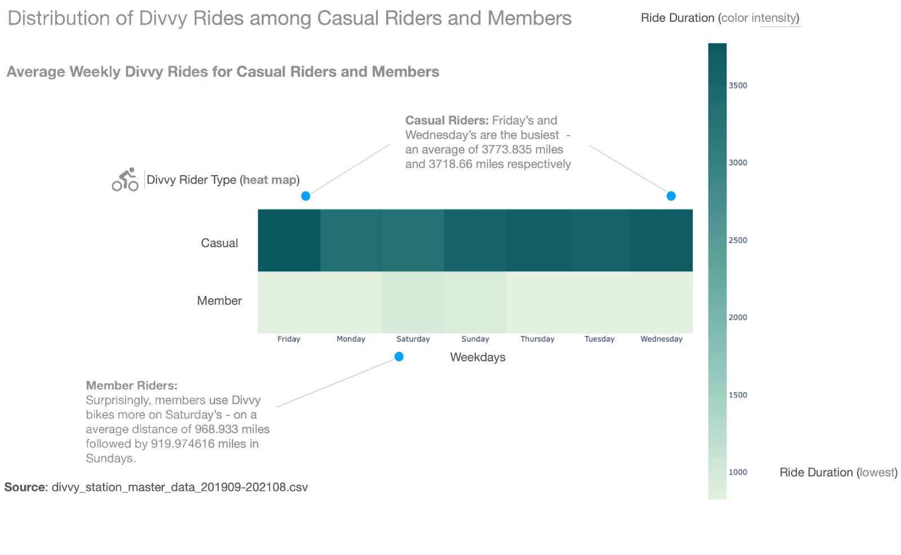
Notes:
This is the ‘Heat Map’ of Divvy rides among casual riders and members. Casual riders are mostly visitors or anyone who are out of state to Chicago.
So, I have used the Divvy station master data from 2019 September - 2021 August. Numbers by itself do not provide much help and that’s where a good visualization can unveil many insights. I created the heatmap using Python Plotly. We’re seeing an average weekly rides for both the casual and member riders. The color gradient dark to light mint indicating highest to lowest divvy rides (in miles).
And, what you see is clear patterns and connections between the available Divvy master data that Casual riders use more Divvy bikes at any particular day compared to Divvy Members, irrespective of any day/temperature or other factors.
Let me highlight some of the interesting findings:
For Casual riders, Fridays are the busiest of all the week with an average of ~3718 miles, followed by Wednesdays with an average of ~3773
Whereas, for Members, Saturdays are the busiest and an average distance of 968 miles are reported followed by 919 miles on Sundays.
This emphasizes that casual riders and members use Divvy bikes for different goals.
Also, we see that the rider distance for members are below 1000 miles and casual riders are above 3500 miles. Usage wise, casual members are bringing in more revenue to Divvy.
It would be wonderful if we could convert these casual riders to members.
By exploring this heatmap, we have explored many facts, which would have been difficult to observe from the numerical data we had in different spreadsheets. We see that some days are busier compared to other days in the week for casual riders and members.
Script: https://docs.google.com/document/d/12kSdY4kfj7t8rvZanUXSvxQkqoSkUIVP-6Gl-EIl13E/edit

Slide 4
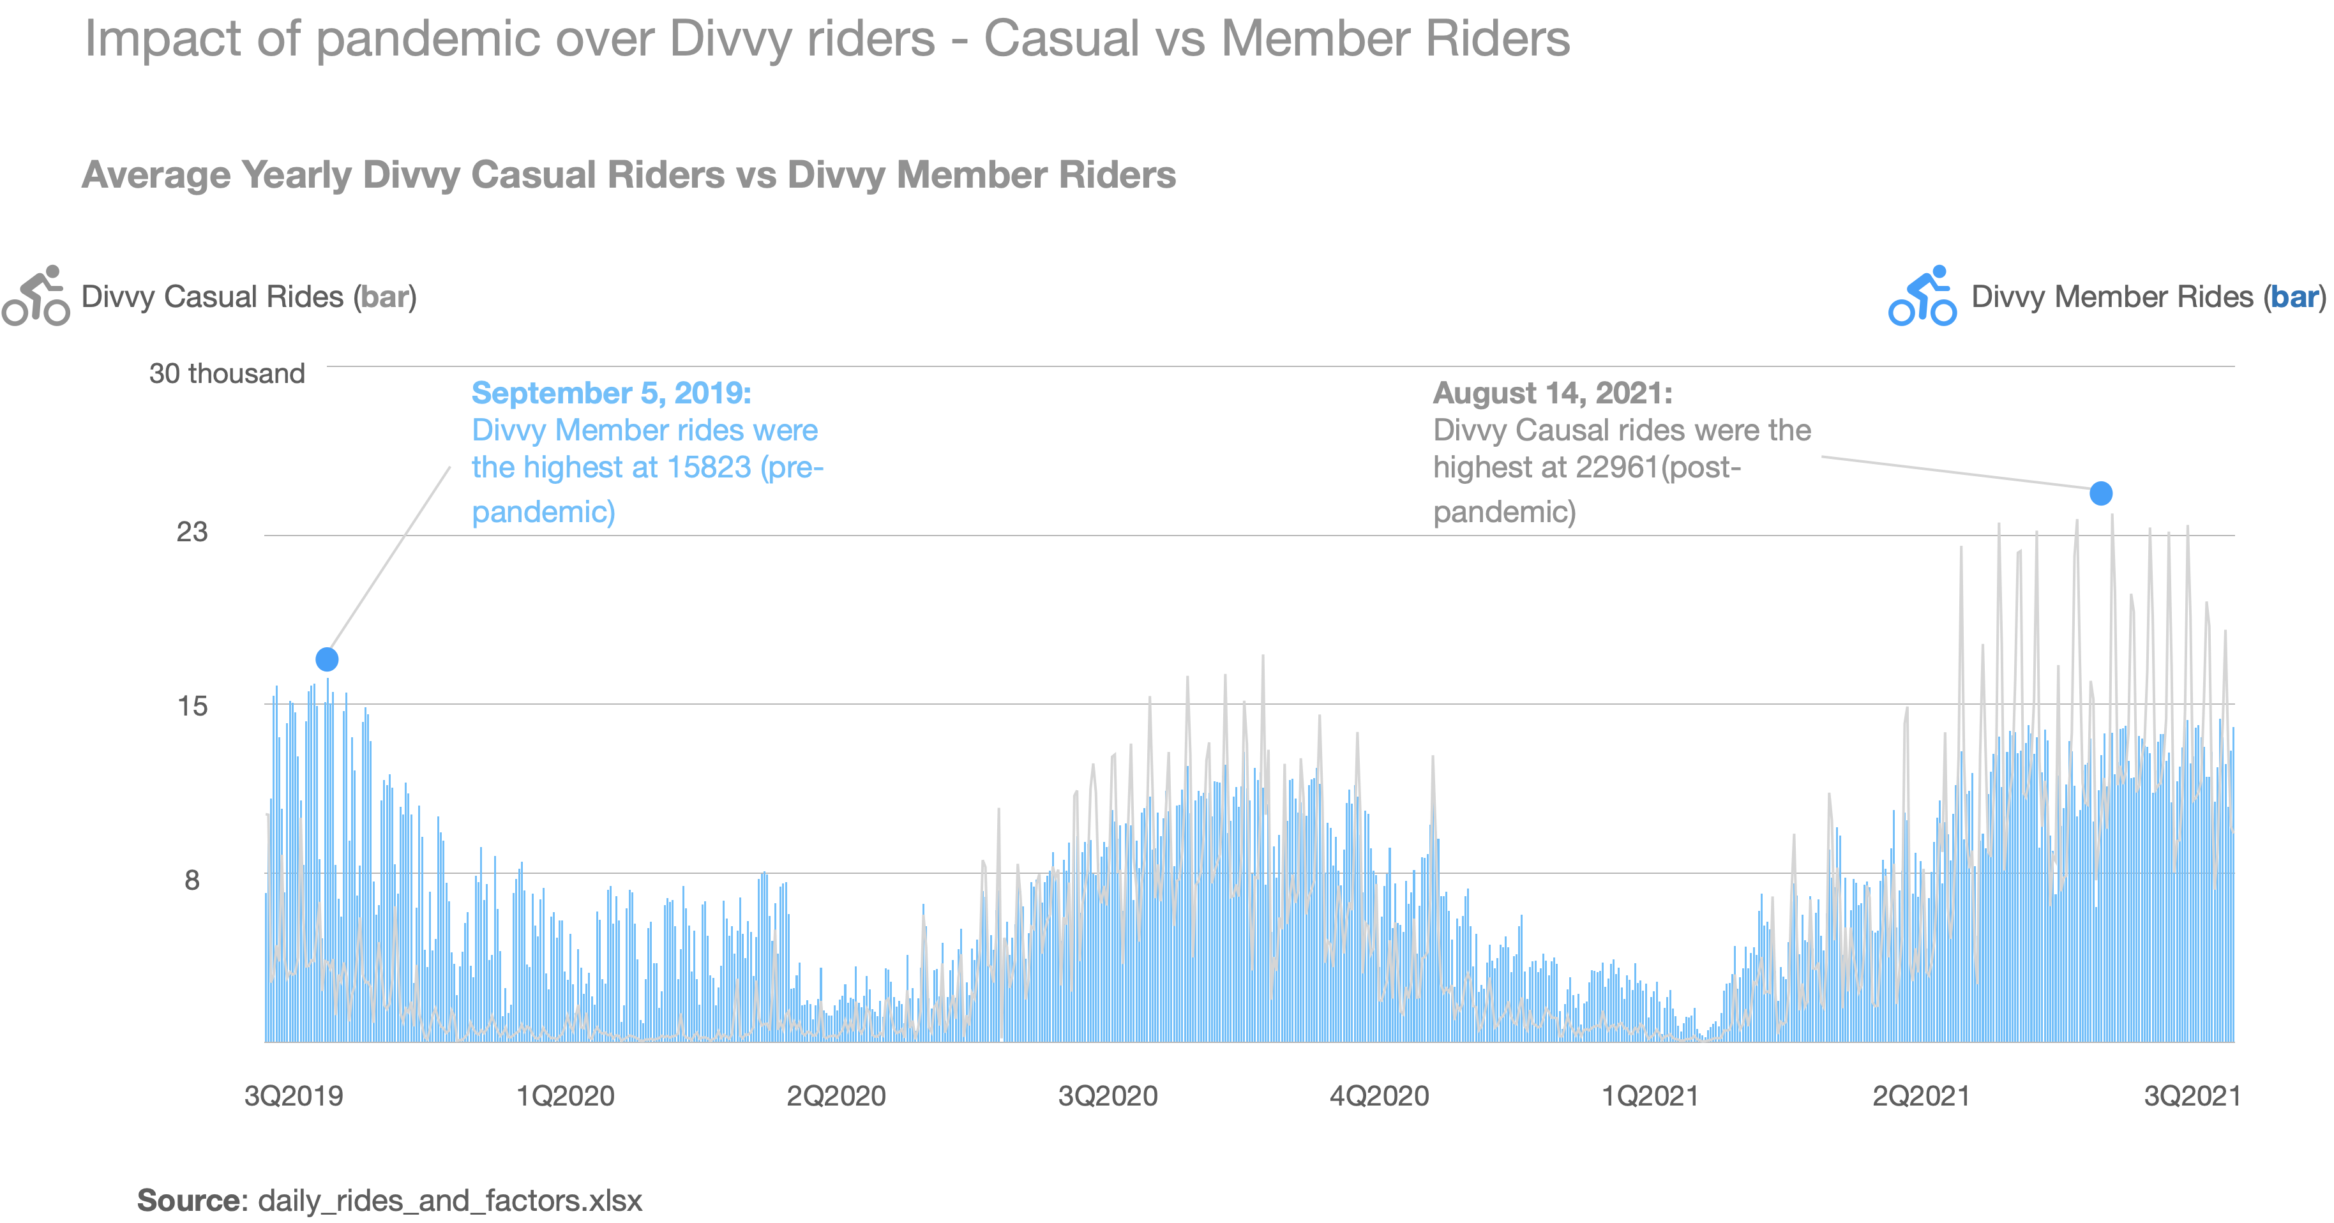
Notes:
This is the ‘Comparison Chart’ of how Divvy riders - Casual and Member rides changed pre and post pandemic. That is, we’ll see if pandemic and the restrictions imposed on CTA has any advantages to Divvy casual or member rides.
I used the Divvy rides and factors data to come up with the visualization. The blue bars represent the Divvy Member riders and the gray bars represent Divvy Casual riders.
As we saw before, casual riders use more Divvy bikes than members. You clearly see patterns and connections between the available data that there is a clear impact of pandemic that have benefited Divvy rides.
I would like to highlight some of the major takeaways:
In Sep 2019 (pre pandemic), Divvy Member rides were high, ~16K whereas Divvy Casual rides were around 9K.
By Sep 2020 (during pandemic), Divvy Casual rides are much higher than Member rides. This is obvious with the public restrictions during pandemic and the imposed CTA restrictions, people choose to use safer transportation means like Divvy, that has eventually surged the Divvy casual rides at ~18K, at the same time Divvy member rides maintains to stay at ~12K.
By Sep 2021 (post pandemic), Divvy casual rides shows a spectacular growth in at about ~23K and Divvy member rides sustains at ~12K.
By exploring this visualization, we see that pandemic has a great impact on Divvy rides. Even after the covid restrictions are lifted, Divvy strives to bring in more revenue than pre pandemic by maintaining customer satisfatcion.
Script: https://docs.google.com/document/d/1EUYuzUXCIaCqLC0ip05vg34-Y9zJbp_QFeNOw1h9lxY/edit

Slide 5
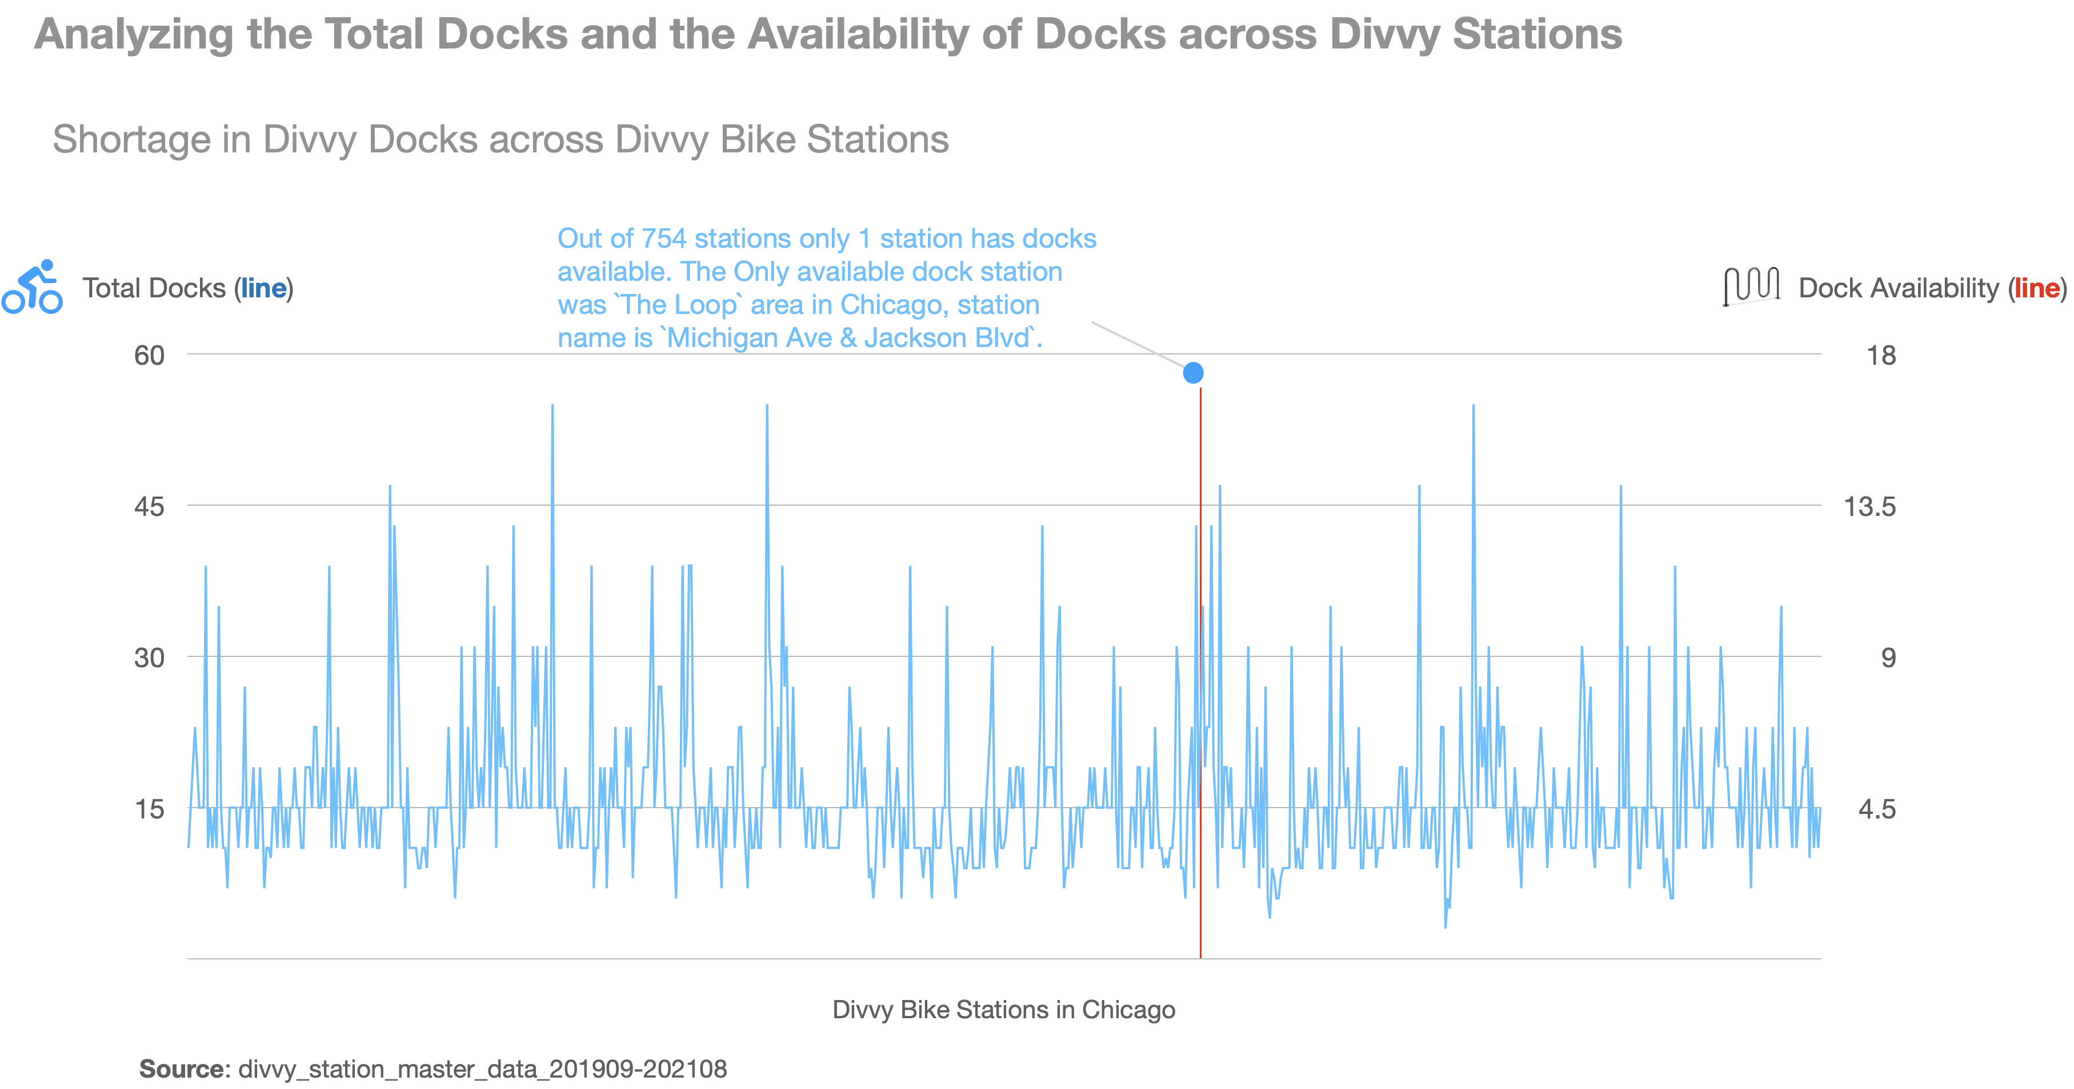
Notes:
This is the “Dock Availability Chart” at different Divvy stations across Chicago. That is, we’re going to explore the data provided to see if Divvy needs to increase it’s inventory at any stations or Divvy already has surplus number of docks across stations. Let’s find out!
I used the the Divvy station master data from 2019 September - 2021 August. The blue lines represent the Divvy ‘Total docks’ and the red lines represent ‘available docks’.
From the chart, it is clearly evident that there is a shortage in Divvy docks across stations. It is hard to find such minute details when just analyzing the reports across multiple spreadsheets.
Let me walkthrough some interesting findings:
We’ve analyzed data spanned acroos 754 rows.
Out of 754 stations, only 1 station has docks available. The only station where the dock station was available was `The Loop` area in Chicago, station name is `Michigan Ave & Jackson Blvd`.
There were a total of 17 docks available. Do we have enough traffic of Divvy bikers in “The Loop’ area? Can we transport some of these docks to some other locations where the traffic is more to address re-balancing. These are some of the factors we, as a team needs to evaluate and take necessary action.
We also need to note that, this is data under consideration is before, during & after pandemic and the dock inavailablity in many stations are due to the fact that Divvy rides have increased significantly during/post pandemic.
By exploring this visualization, we see that surge in Divvy rides has led to shortage in Divvy docks availability across Chicago and this needs to addressed promptly to reduce customer churn.
Script: https://docs.google.com/document/d/1OKNYb1C8uv1p47ErkbqFaJiDqmEXOqNWKxnmoNWHOHs/edit

Slide 6
Thank You
Notes:
That is from my end. I would like to handover this back to our Project Lead, to continue with his updates. Thank you so much.

